Slide 1
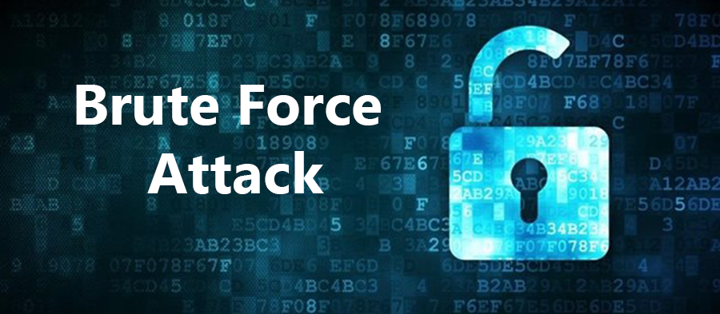
Brute-force Attacks: Simulate, Analyze, Defend
Understanding and Preventing Weak Authentication Exploits through Practical Testing

Slide 2
Simulating and Defending Against Brute-Force Attacks
Simulate brute-force attacks on vulnerable web login forms and SSH services
Use tools like Burp Suite and Hydra to replicate attacker techniques
Understand how attackers exploit weak authentication systems
Highlight risks of poor credential security through hands-on exercises
Demonstrate practical mitigation strategies to defend against brute-force intrusions
Explore attack methods on web logins and SSH using Burp Suite and Hydra, and learn practical defense techniques.

Slide 3
Essential Prerequisites for Project Success
Basic understanding of HTTP requests and web forms
Familiarity with the Linux terminal
Access to Kali Linux or a Linux distro with Hydra and Burp Suite installed
A vulnerable web app such as bWAPP or DVWA set up locally or on a virtual machine
These foundations ensure effective tool use and accurate attack simulations
Build foundational skills for effective tool use and accurate attack simulations

Slide 4

Lab 1: Brute-force Login Attack with Burp Suite
Use Burp Suite Intruder’s Cluster Bomb to uncover weak login credentials
Intercept login requests to analyze authentication flow.
Configure Burp Suite Intruder with Cluster Bomb attack type.
Set payloads for username and password fields to automate attempts.
Analyze server responses to identify valid login credentials.
Demonstrate how automated brute-force attacks exploit weak login mechanisms.

Slide 5
Configure Burp Suite Brute-Force Attack
Open bWAPP and navigate to the login page
Intercept a login request with dummy credentials in Burp Suite
Right-click the intercepted request and select Send to Intruder
Select the Cluster Bomb attack type for payload combinations
Set payload positions: Username as payload 1, Password as payload 2
Use small username and password lists to optimize testing efficiency
Step-by-step guide to setting up and launching the attack using bWAPP and Burp Suite

Slide 6
Execute and Monitor Brute-Force Attack
Identify valid credentials by tracking attack status and response lengths
Start the attack while continuously monitoring status updates and response lengths
Detect valid username-password pairs by analyzing variations in response sizes
Confirm that a valid credential pair emerges from test payload lists
Demonstrate how brute-force attacks can bypass weak login protections
Summarize: Monitoring response lengths is key to identifying successful login attempts

Slide 7

Automating Web Form Brute-Force with Hydra
Lab 2 teaches efficient credential discovery by automating attacks on web login forms using Hydra commands.
Identify web form action URLs and input field names accurately
Run Hydra commands to automate testing of username-password pairs
Monitor Hydra output to detect valid credentials through server response patterns
Demonstrate the efficiency of automated brute-force attacks on web forms
Understand practical application of Hydra for penetration testing and security analysis

Slide 8
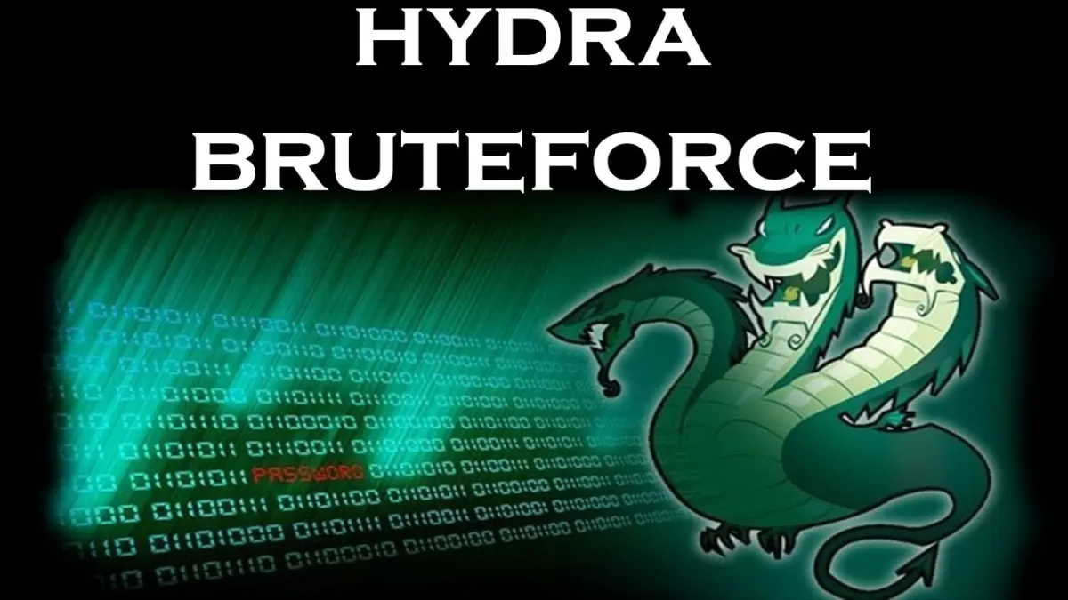
Master Hydra Web Form Brute-Force
Step-by-step approach to identify valid credentials using Hydra
Identify the form action URL and input field names (e.g., login.php, login, password)
Run Hydra with the command including username, password list, target IP, and form details
Replace the error message placeholder with the exact server response on failed login
Monitor Hydra output to detect valid username-password combinations
Expected outcome: Hydra identifies valid credentials by analyzing server responses

Slide 9

Final Project Deliverables
Submit comprehensive evidence of cybersecurity skills and mitigation strategies
A detailed report including screenshots from both labs
Examples of Hydra command syntax for various services
A list of valid username-password pairs discovered (for lab use only)
A checklist of mitigation strategies to prevent brute-force attacks
These deliverables demonstrate practical understanding and reinforce cybersecurity defense skills.

Slide 10

..THANK YOU..

